Slide 1



Machine learning techniques for high-throughout analyses of TR-PES measurements
Convolutional Neural Networks employed to fit XPS spectra
Arthur Julien, Jean-Baptiste Puel, Philip Schulz
18/03/2024

Slide 2
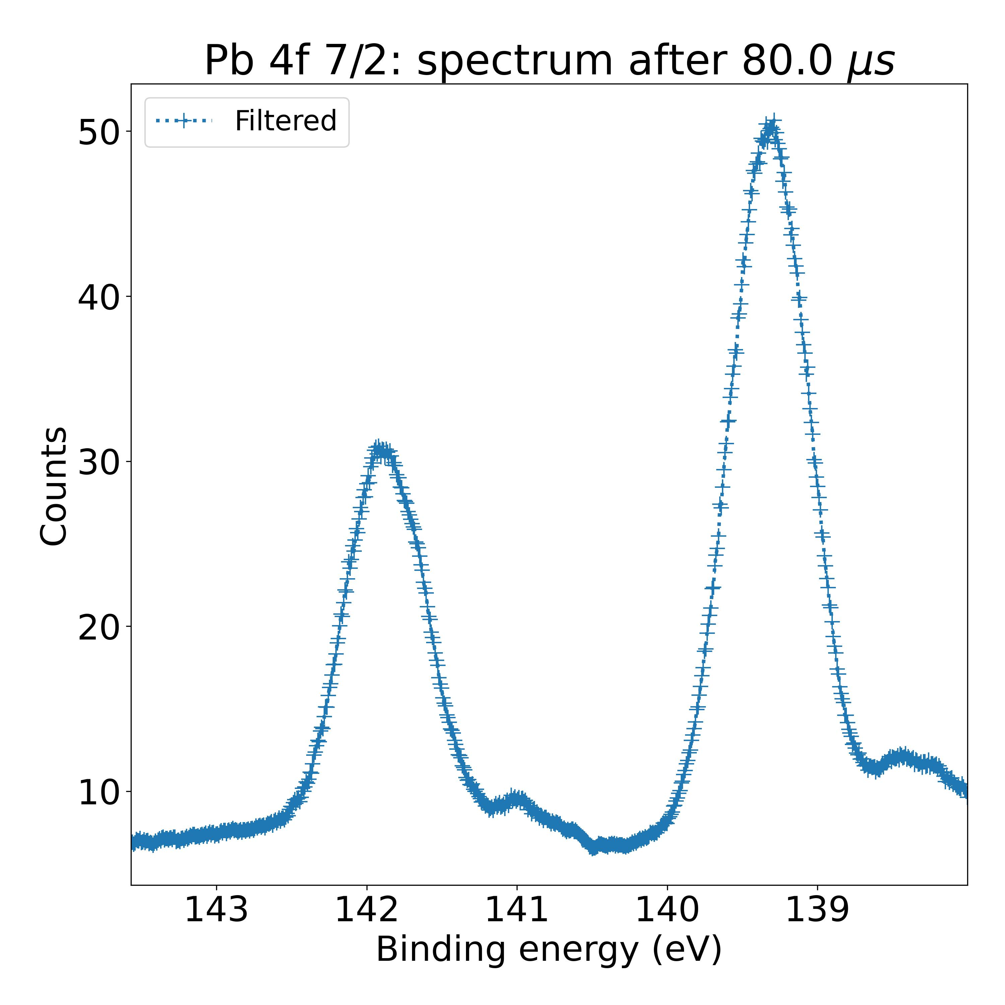
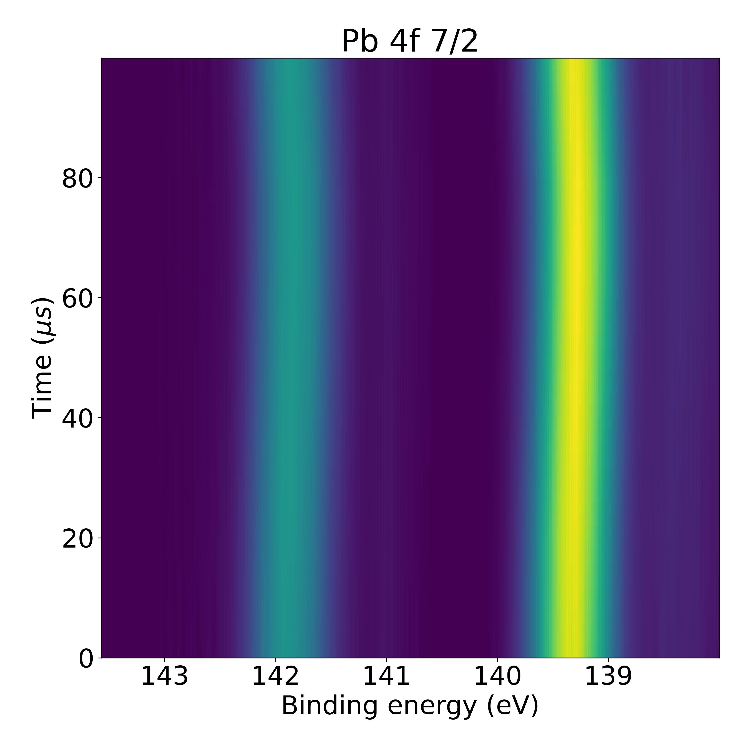
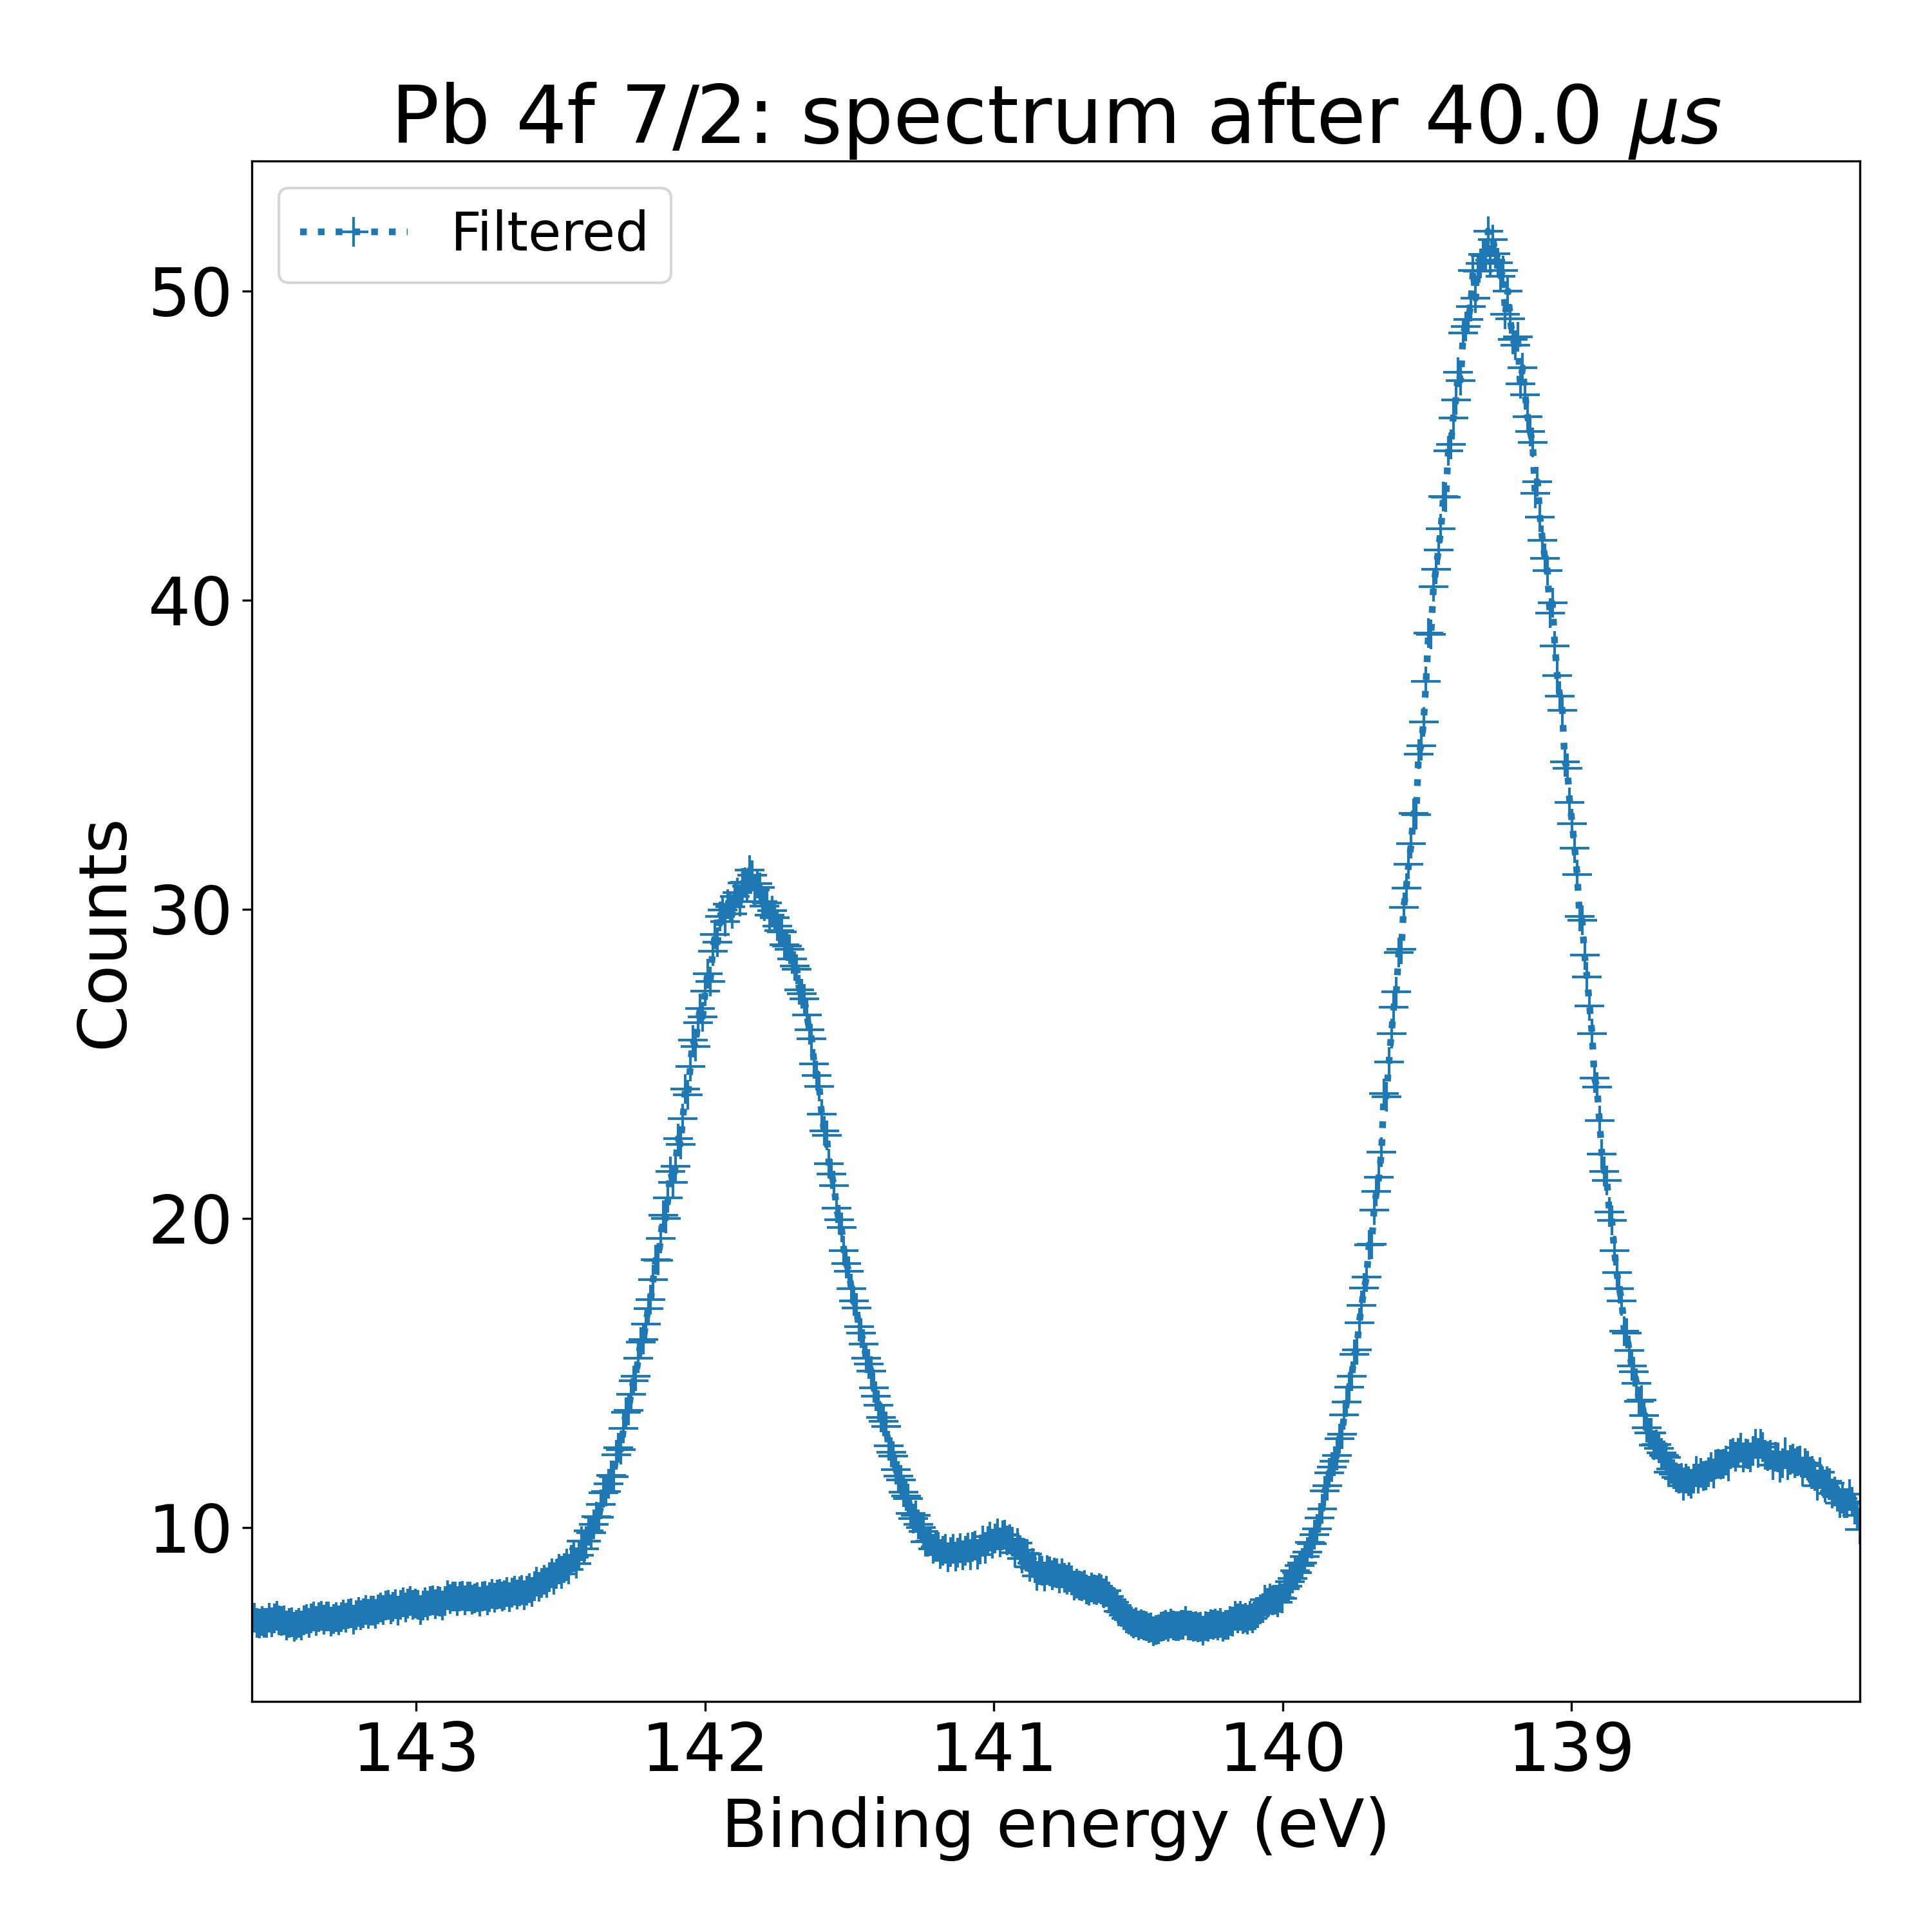
Context: time resolved XPS measurements
Objective of the experiment: quantify changes of material properties upon illumination
Laser on
Laser off
Laser on
Laser off
1000 XPS spectra to analyze
High throughput analysis methods are necessary

Slide 3
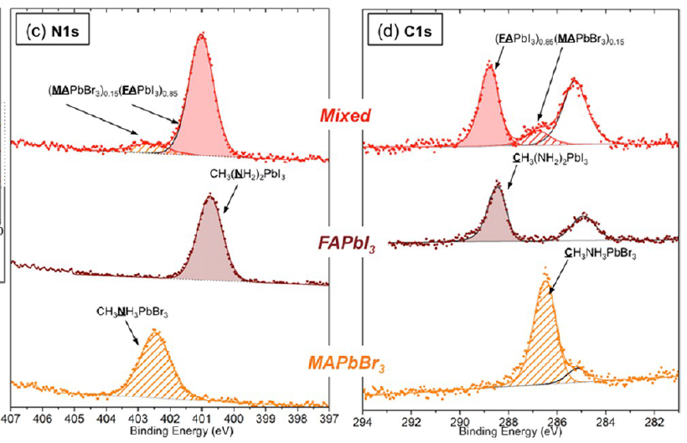
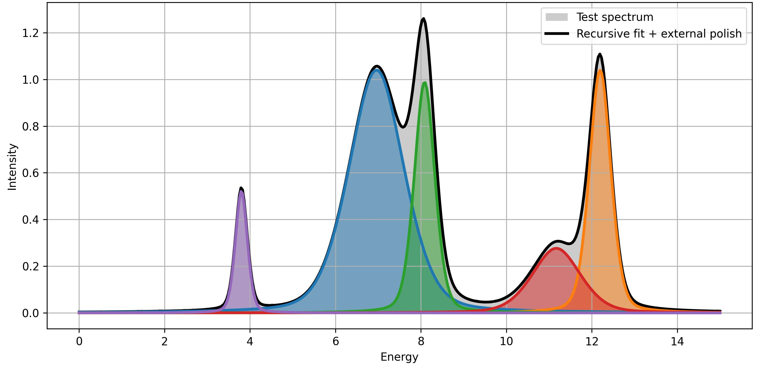
Objective: high throughput fits of XPS spectra
Two different contributions in mixed composition
Two different chemical environments for nitrogen atoms
Fitting procedure must allow to distinguish peak contributions in XPS spectra
Jacobsson, T. J., Correa-Baena, J. P., Halvani Anaraki, E., Philippe, B., Stranks, S. D., Bouduban, M. E. F., Tress, W., Schenk, K., Teuscher, J., Moser, J. E., Rensmo, H., & Hagfeldt, A. (2016). Unreacted PbI2 as a Double-Edged Sword for Enhancing the Performance of Perovskite Solar Cells. Journal of the American Chemical Society, 138(32), 10331–10343.

Slide 4
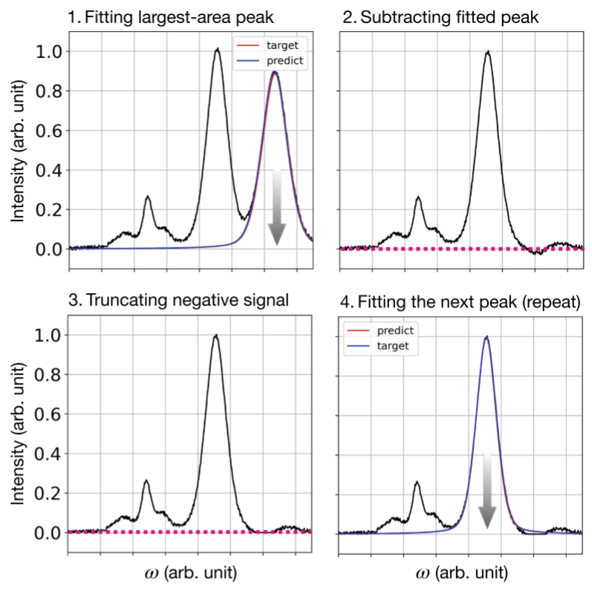
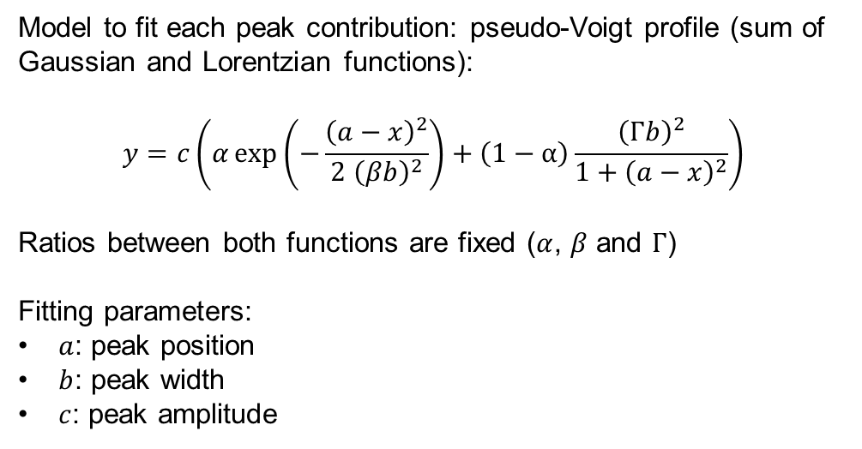
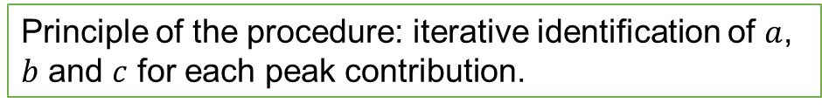
Iterative identification of major peak
Model to fit each peak contribution: pseudo-Voigt profile (sum of Gaussian and Lorentzian functions):
$$y=c\left(α\exp\left(−\frac{{\left(a−x\right)}^{2}}{2{ \left(βb\right)}^{2}}\right)+\left(1−α\right)\frac{{\left(Γb\right)}^{2}}{1+{\left(a−x\right)}^{2}}\right)$$
Ratios between both functions are fixed ($α$, $β$ and $Γ$)
Fitting parameters:
$a$: peak position
$b$: peak width
$c$: peak amplitude
Principle of the procedure: iterative identification of $a$, $b$ and $c$ for each peak contribution.
Convolutional neural networks
Park, S. H., Park, H., Lee, H., & Kim, H. S. (2021). Iterative peak-fitting of frequency-domain data via deep convolution neural networks. Journal of the Korean Physical Society, 79(12), 1199–1208.
Procedure proposed by Park et al. in: Iterative peak-fitting of frequency-domain data via deep convolution neural networks. Journal of the Korean Physical Society, 79(12), 1199–1208.

Slide 5

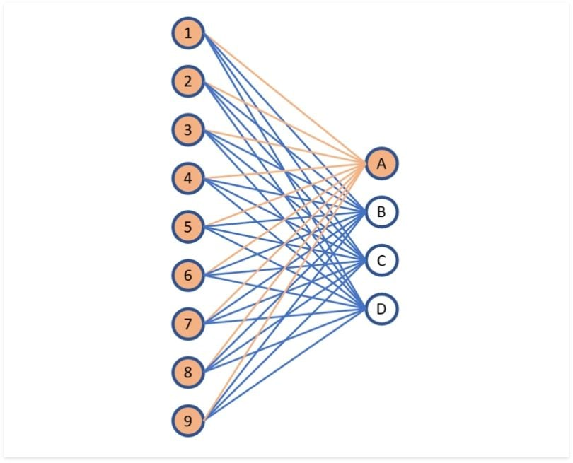

Convolutional neural networks
Principle of convolution neural networks: serial connection of convolution products and filters
Convolution layer: convolution with a kernel
Filtering / subsampling layer:
Fully connected layer:
All inputs are connected to outputs
Weights of the connections are optimized during training
Parameters that are optimized during training
Max pooling

Slide 6
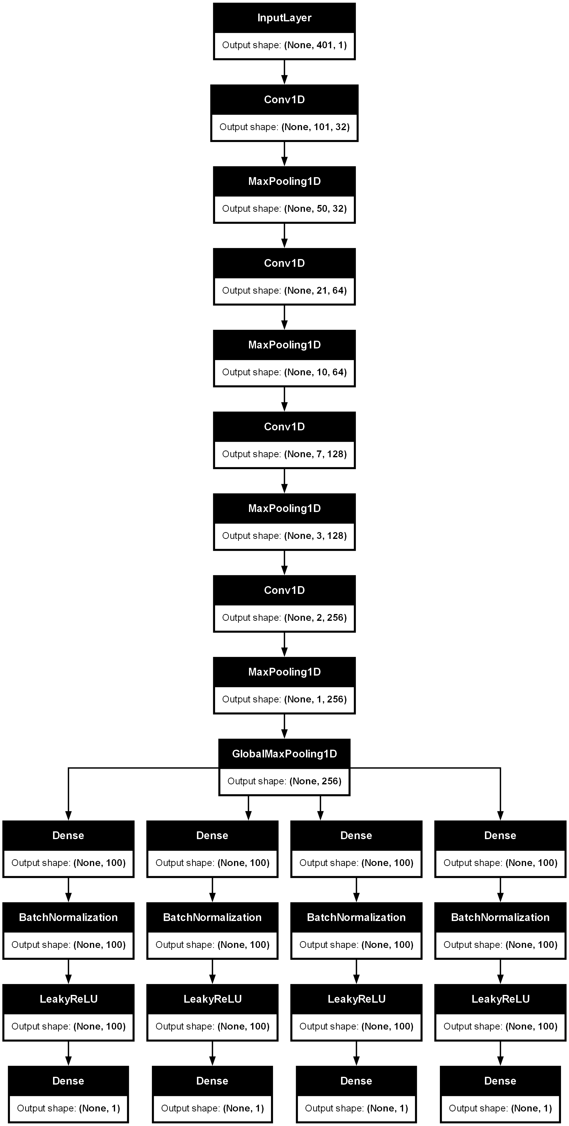
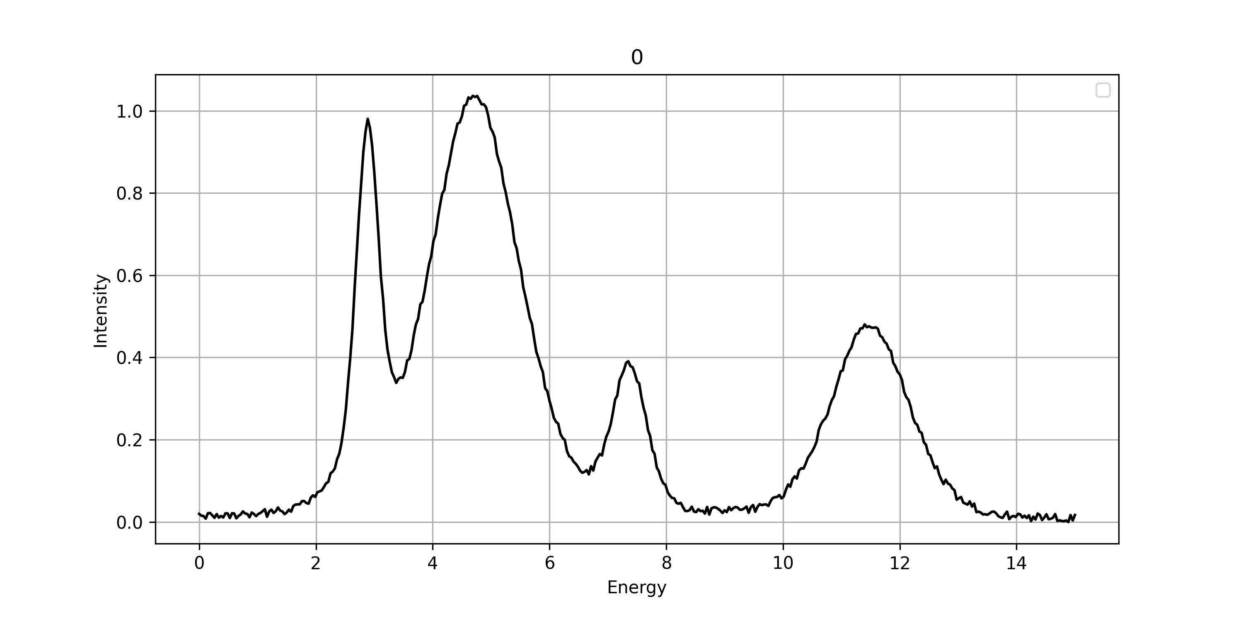
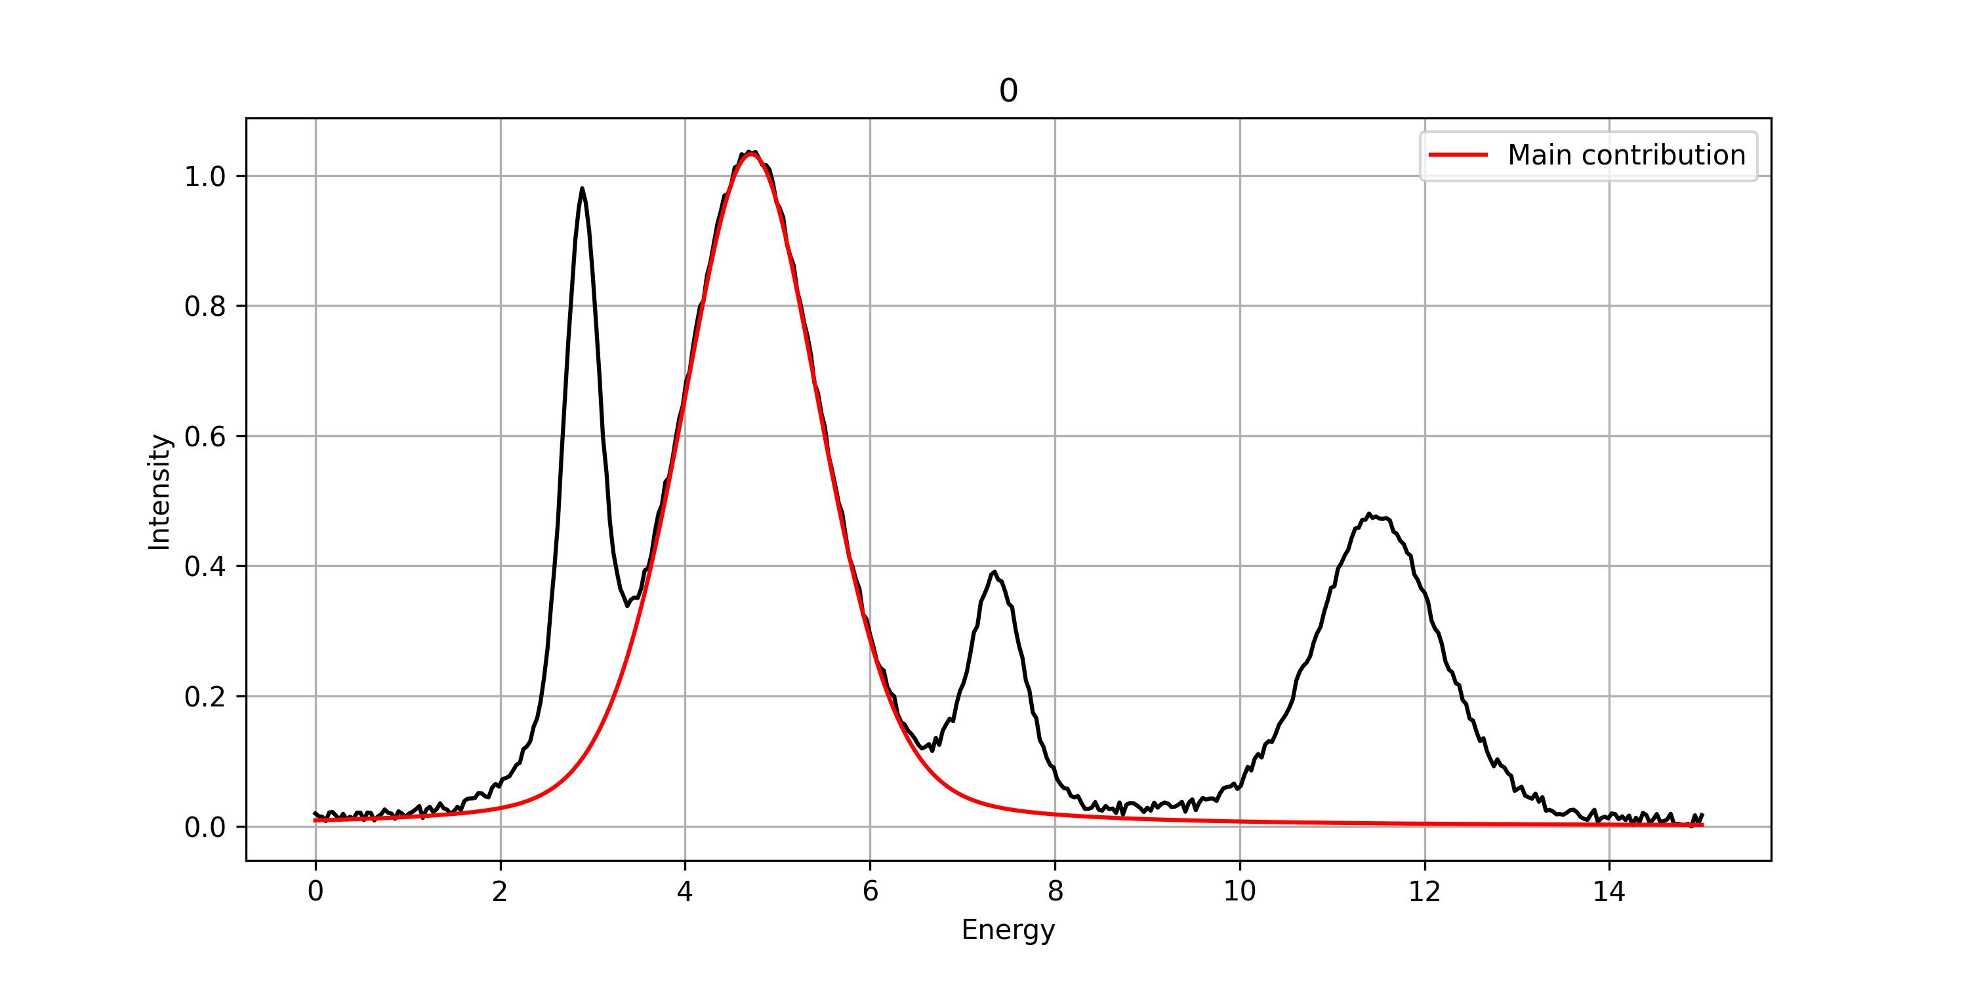
Convolutional neural networks for peak identification
Input: 1D vector containing one XPS spectrum
Contemporary CNNs include now significantly more layers:
Activations functions
Normalizations
Random perturbations
…
Convolution layer
Filtering layer
Outputs: four values:
Major peak position
Major peak width
Major peak amplitude
Total number of peaks
Training of CNN is necessary to adjust internal parameters and obtain desired outputs

Slide 7
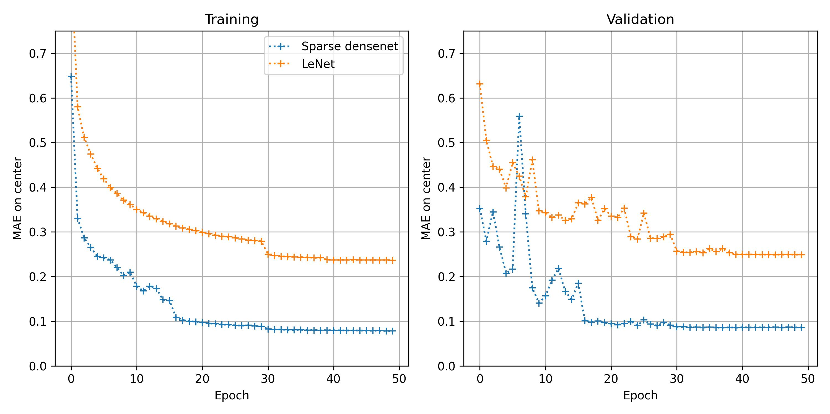
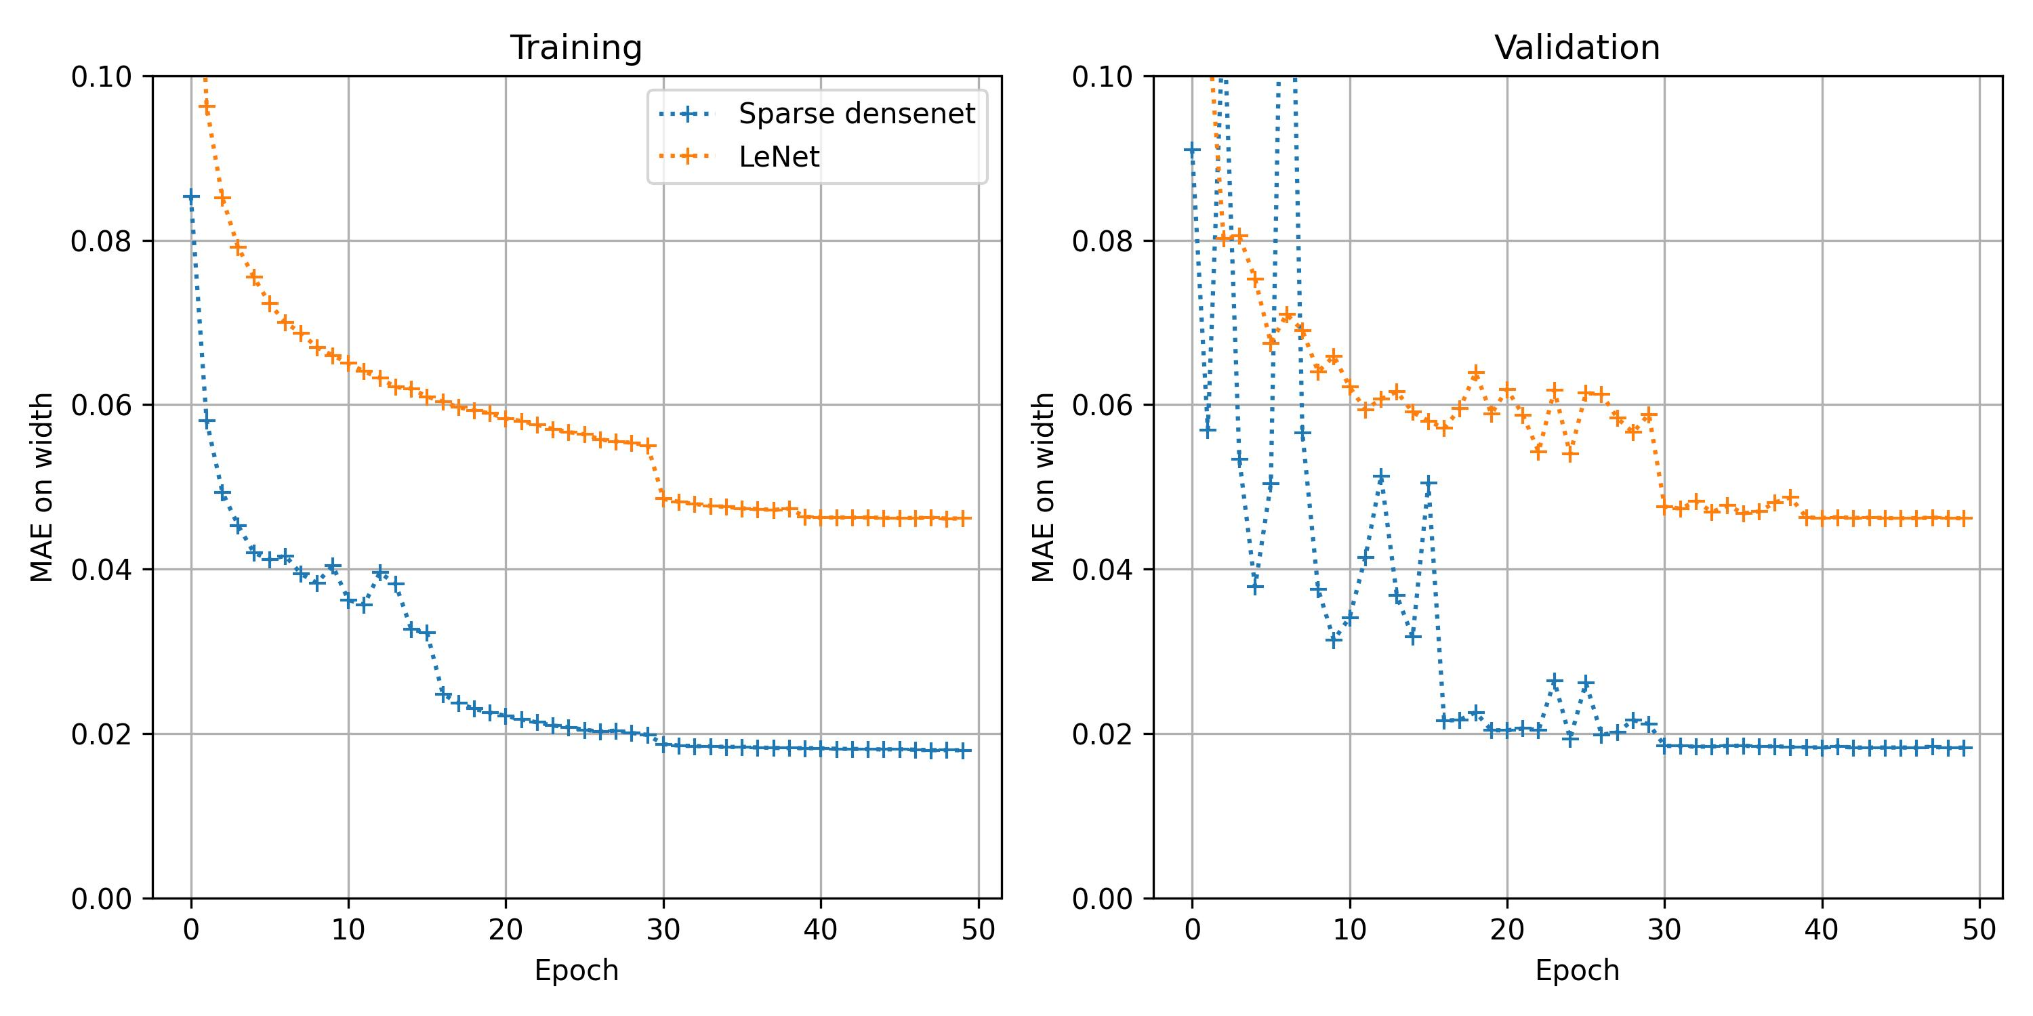
Training CNNs
Sparse densenet: model developed by Park et al.
LeNet: first simple CNN
Training database:
Each entry is synthetized with the sum of 1 to 5 contributions
Total spectrum | Major peak position | Major peak width | Major peak amplitude | Total number of peaks
. . .
 | 4.51 | 0.87 | 0.94 | 4
. . .
MAE on major peak position
~ 1 000 000 entries
MAE on major peak width
Input of CNN
Outputs of CNN
Internal parameters of CNN are optimized to minimize error between CNN outputs and true values.
Exploration of CNN internal parameters is automatized.
Error is quantified with Mean Absolute Error: MAE
Optimization of CNN internal parameters

Slide 8
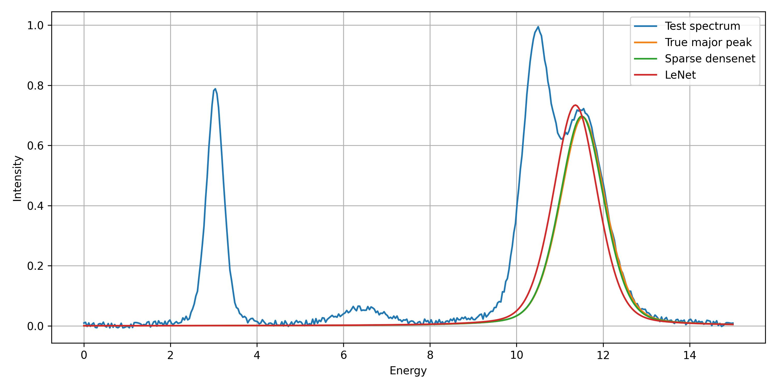
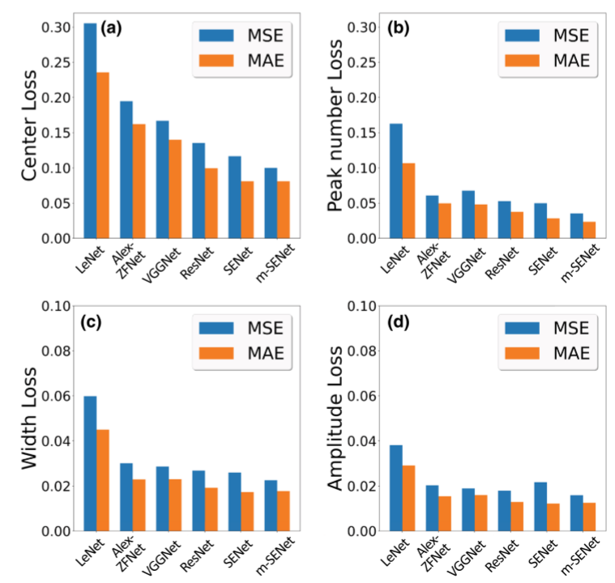
Testing CNNs
Statistical error over test database:
Test database:
Similar database to training
Distinct entries employed to evaluate performances on new cases
~ 150 000 entries
 | Sparse densenet | LeNet
MAE on major peak position | 0.09 | 0.25
MAE major peak width | 0.02 | 0.05
MAE major peak amplitude | 0.01 | 0.03
MAE on total number of peaks | 0.03 | 0.1
Average fit time | 1.4x10⁻³ s | 1.1x10⁻⁴ s
Example of test result
Similar results to Park et al. (1 200 000 entries training database)
Results obtained here (1 000 000 entries) training database
Almost perfect superposition of CNN result and true major peak

Slide 9
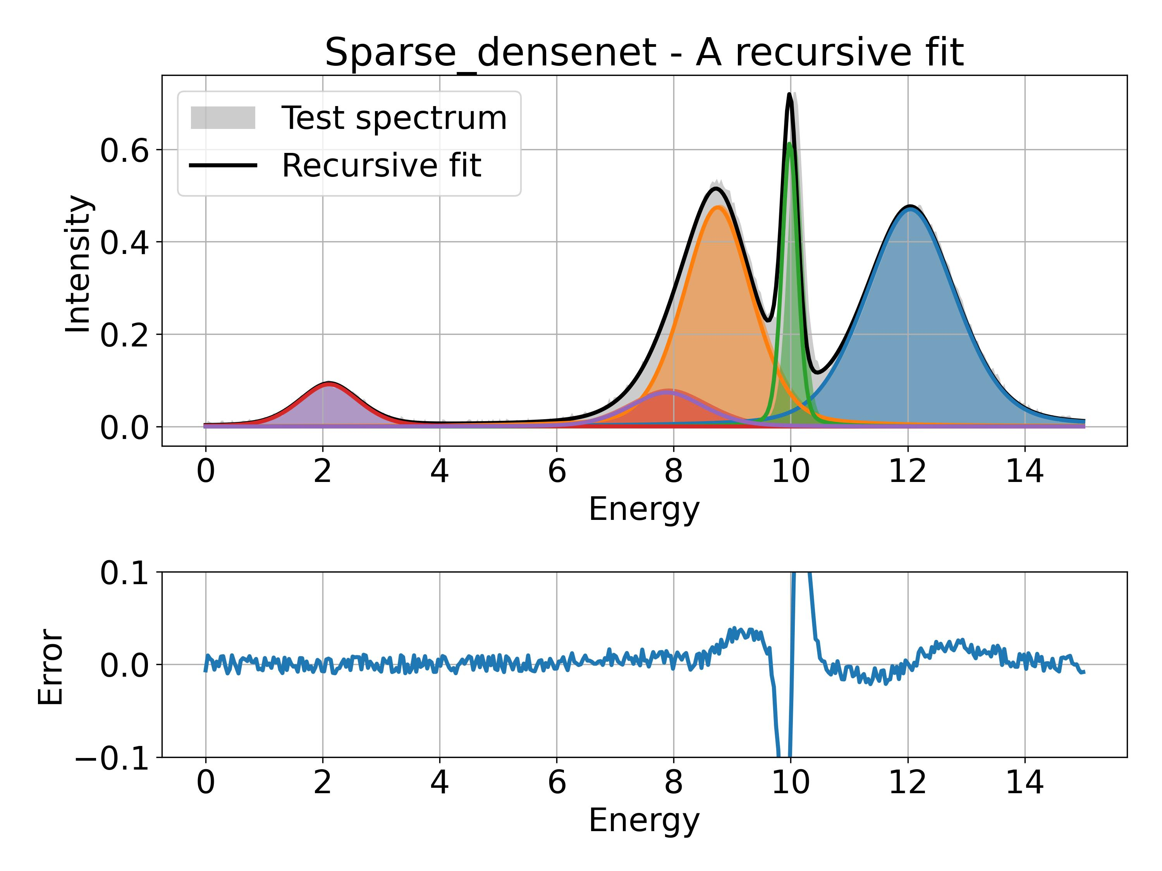
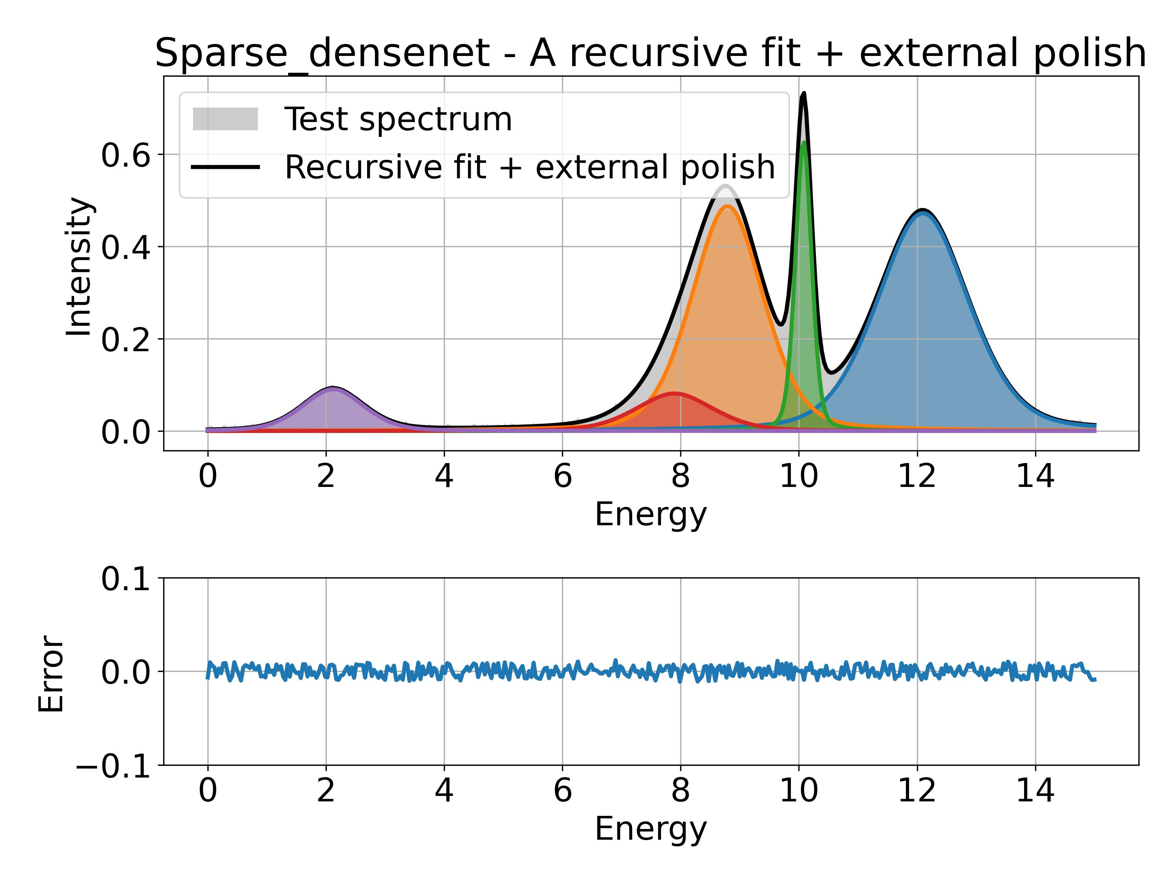
Iterative application of CNN
Neural network as been developed and trained on the identification of one peak
It is applied iteratively to find several contributions in a spectrum
CNN is applied 5 times to iteratively find the remaining major peak
+
Least square reduction fit initialized by CNN results to “polish” results
CNN is applied 5 times to iteratively find the remaining major peak
Good results but still errors
Almost perfect fit
Average processing time: 0.21 s per spectrum
Average processing time: 2.22 s per spectrum

Slide 10
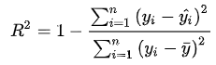
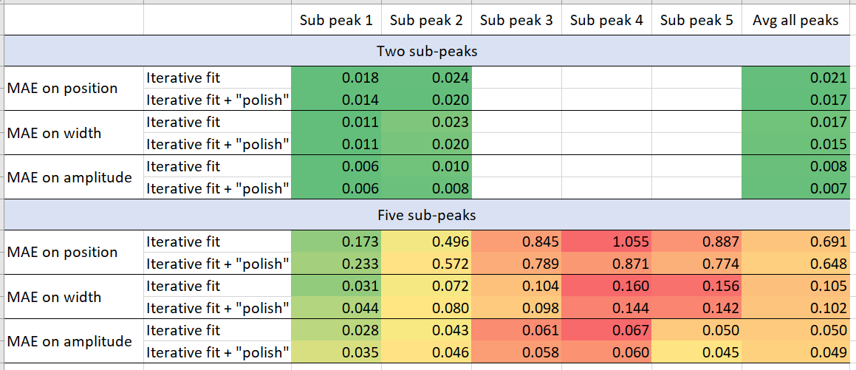
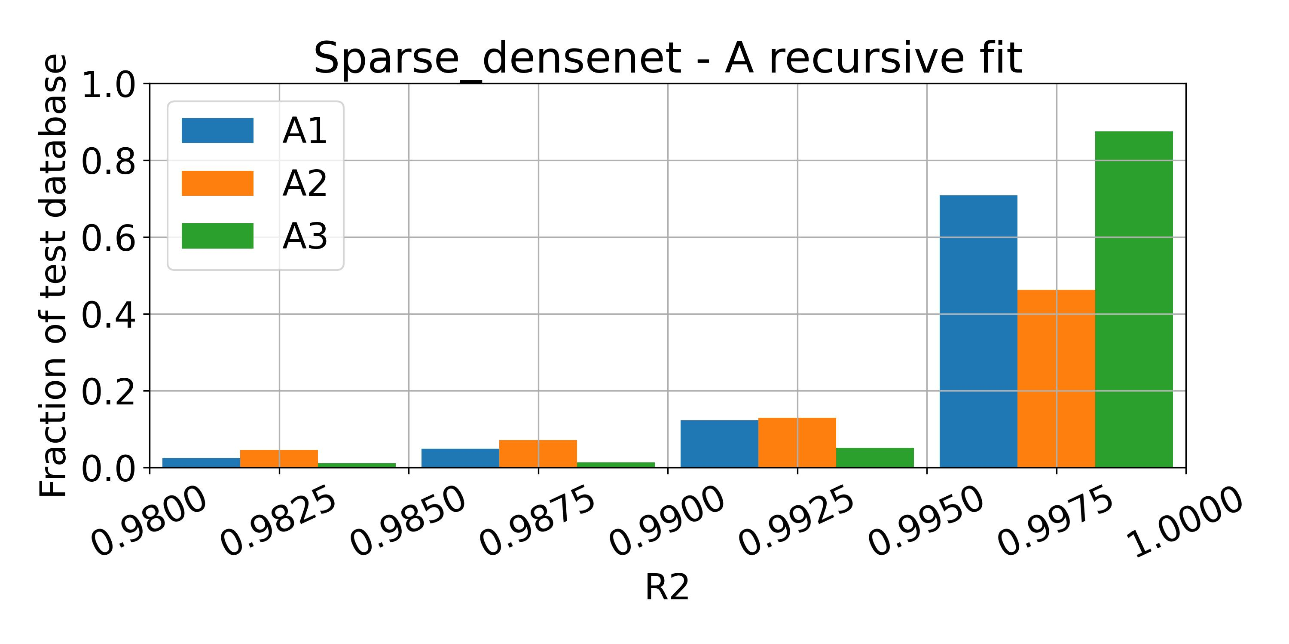
Iterative application of CNN: statistical results
Overall fit quality is evaluated through R² coefficient for total spectrum:
Mean Average Error for each peak parameter:
(only cases with two or five contributions)
Fit quality is sufficient when R² > 0,995 (empirical threshold)
Distribution of R² obtained over 500 test spectra:
More good fits
Lower average error after polishing
Iterative fit
Iterative fit + “polish”
Less fits of too low quality
Remaining contributions are more noisy and more sensitive to accuracy of previous fits
Polishing step improves fit quality
Even in most difficult cases (five contributions), average error remains low
Statistics over iterative fit quality were not evaluated by Park et al.
Fits to be improved by polishing step
Good fits

Slide 11
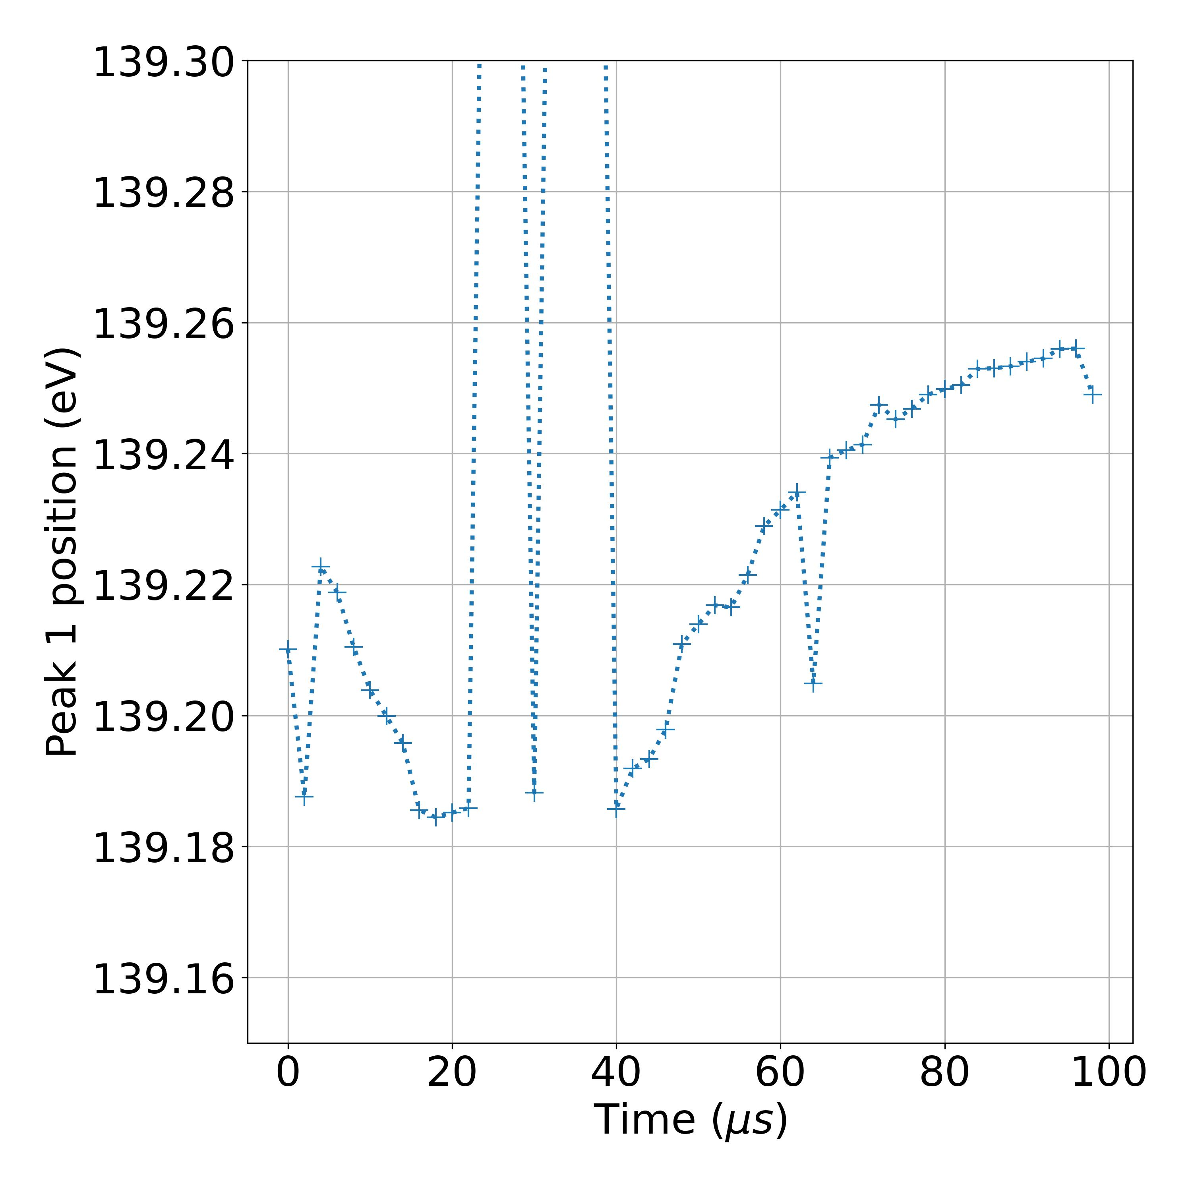
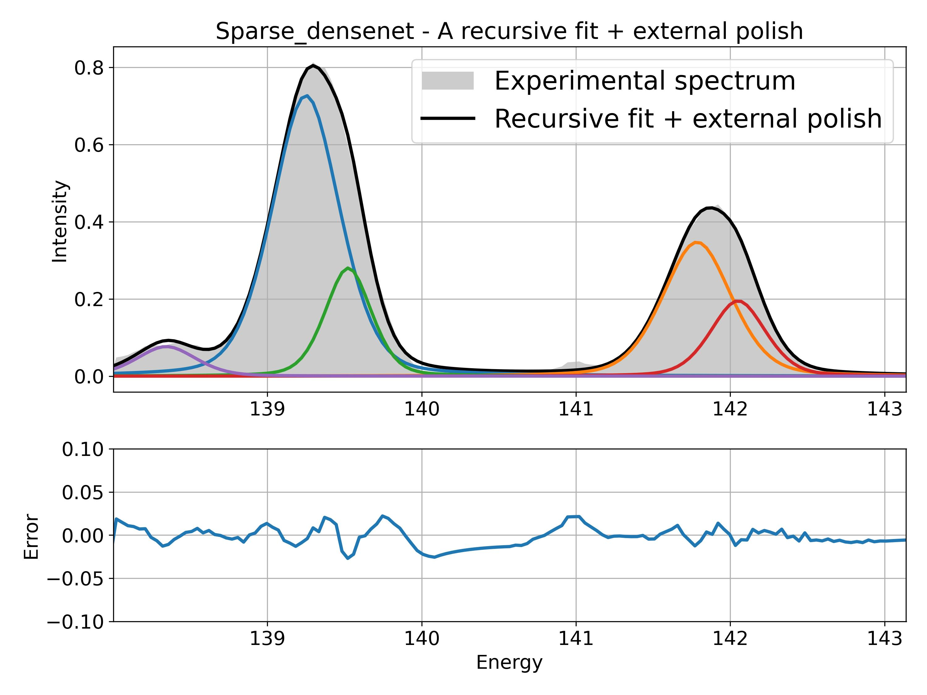
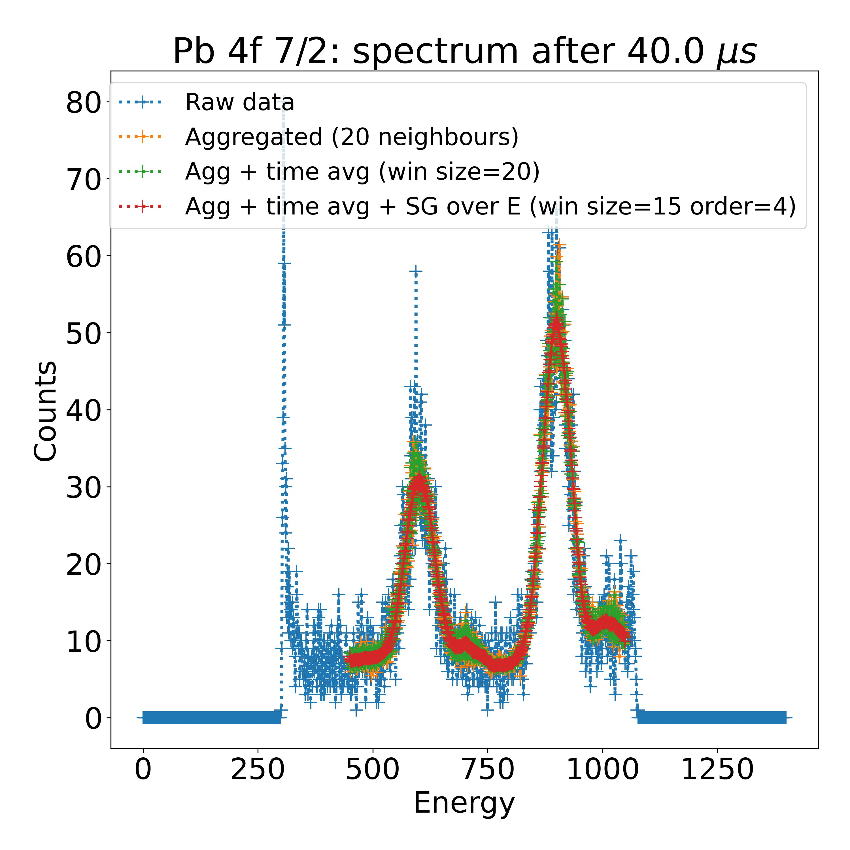
Results on experimental measurements
Measurement of Pb 4f:
Total fit time (50 spectra): 4 min
Evolution of first peak contribution:
4f 5/2
4f 7/2
Filtering noisy experimental data
Laser off
Laser on
Two contributions found for both peaks: need of further optimization ?

Slide 12
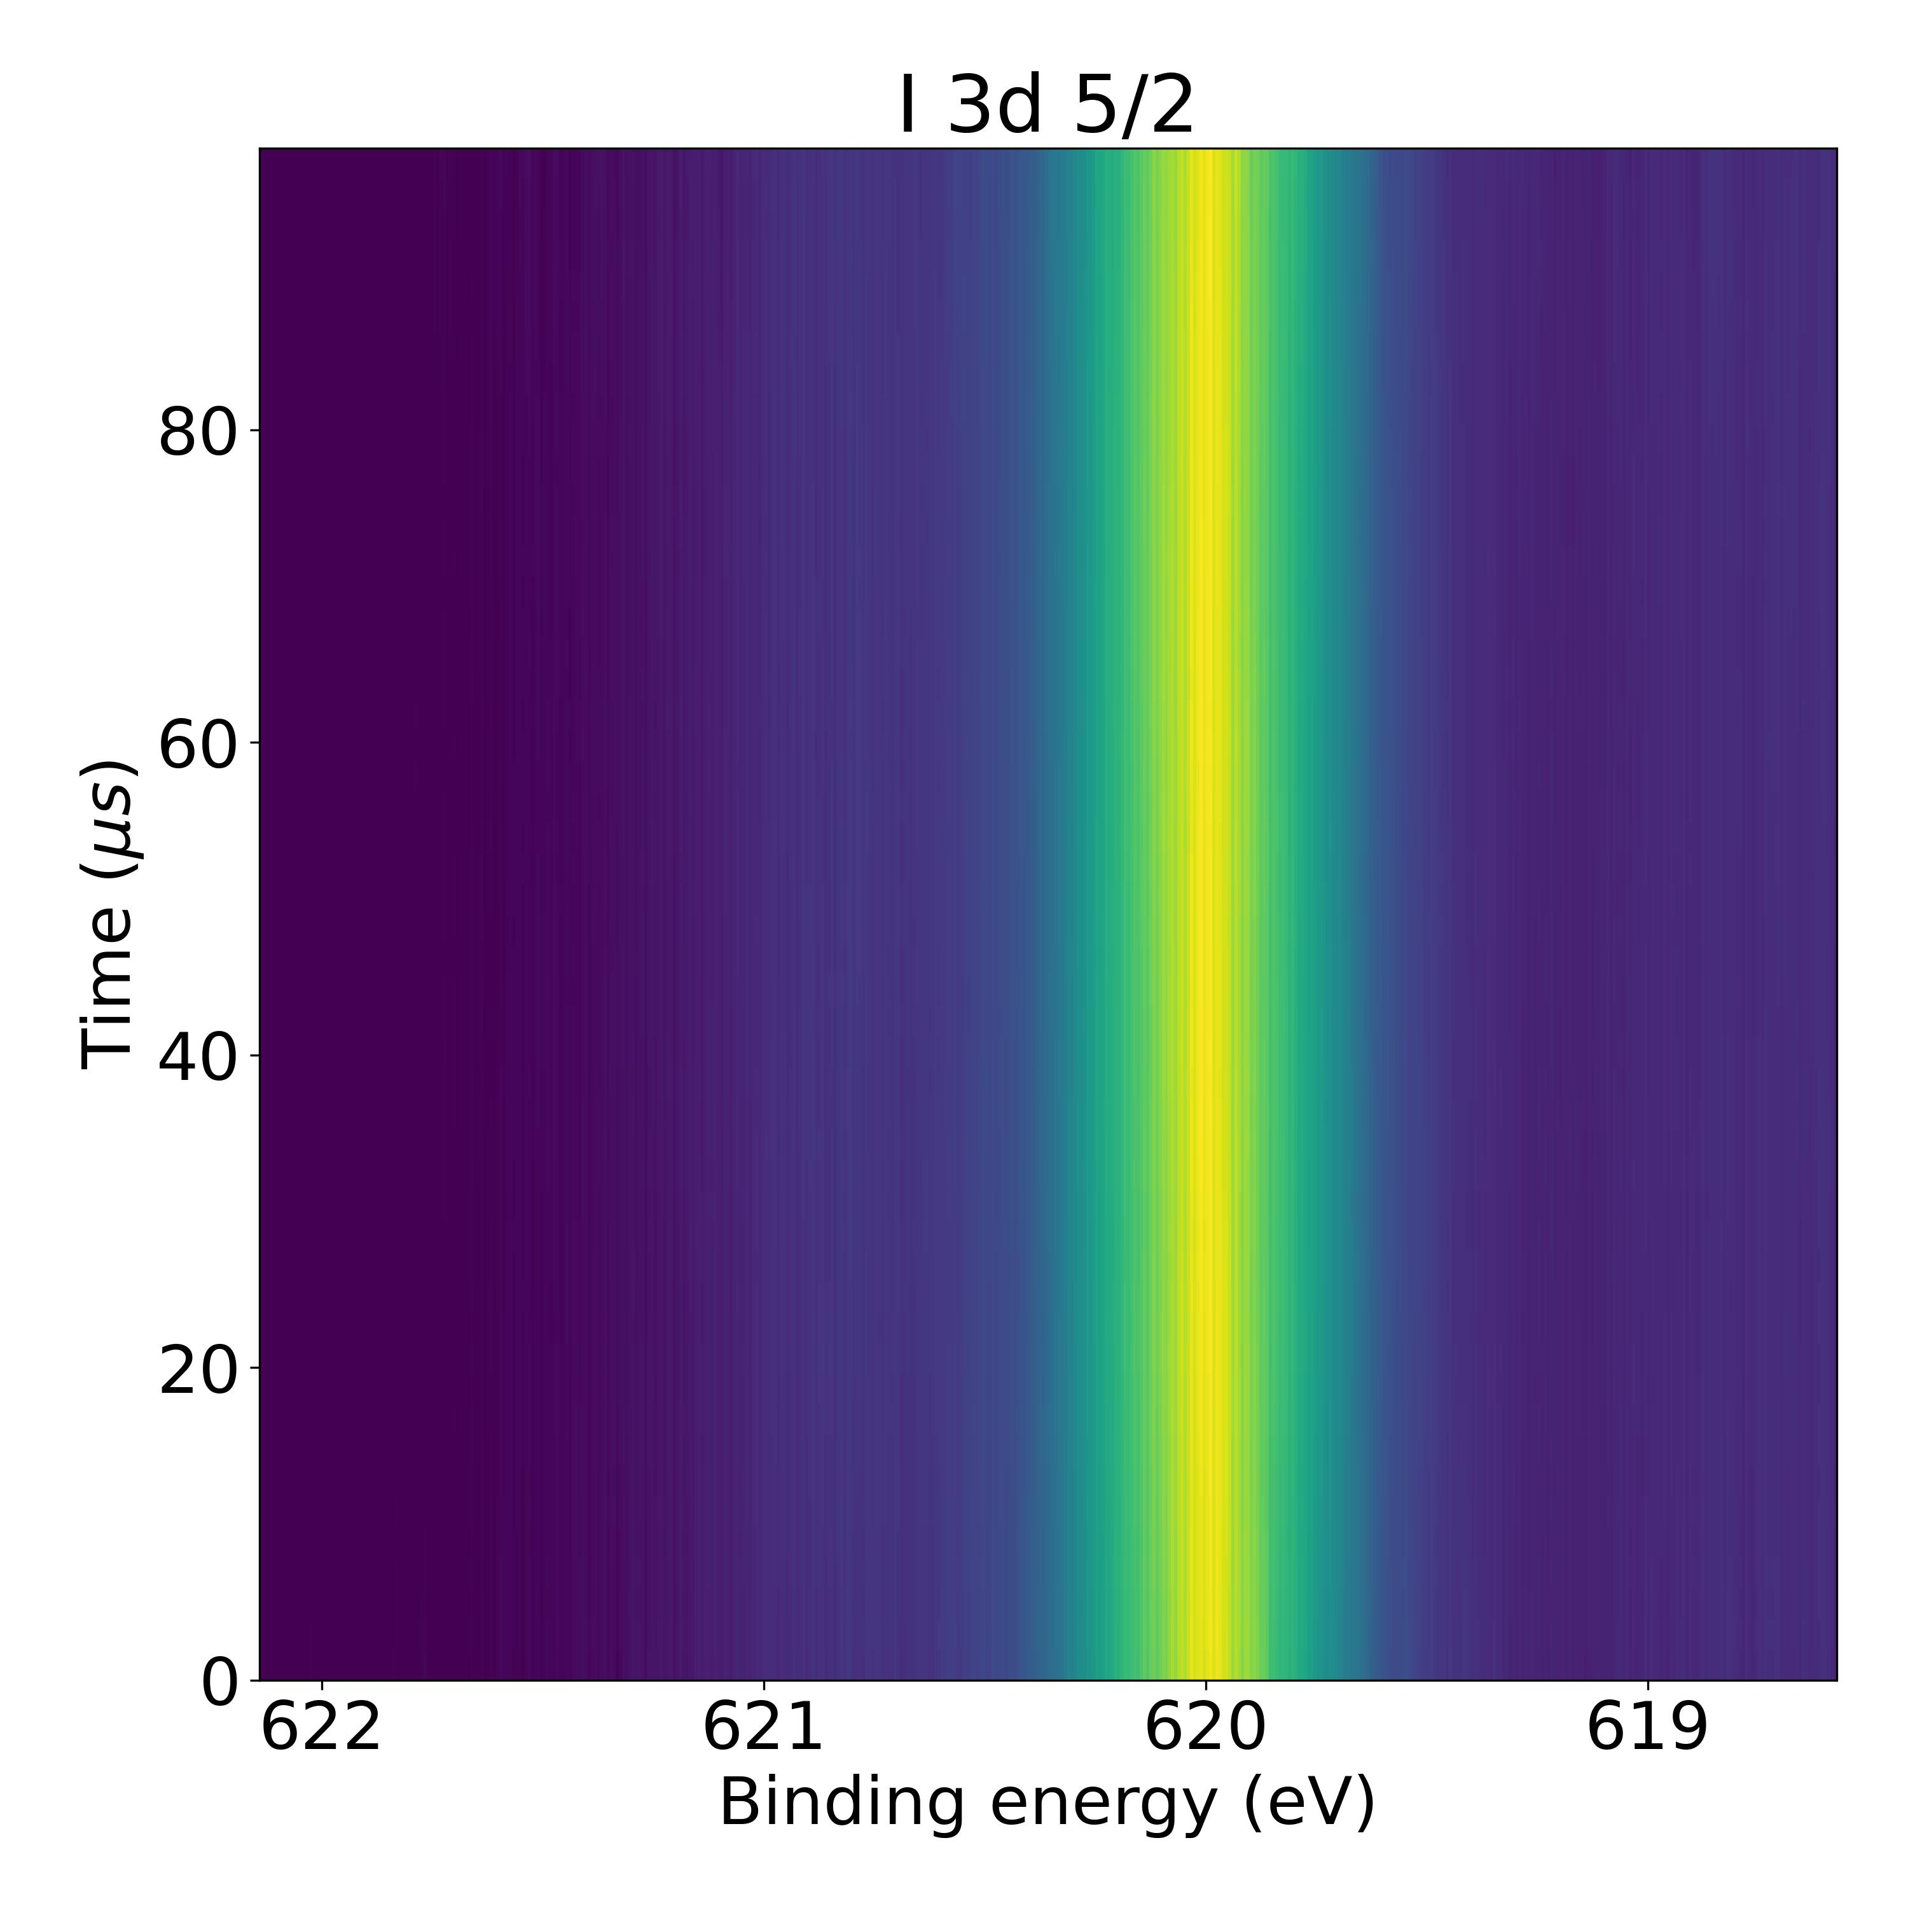
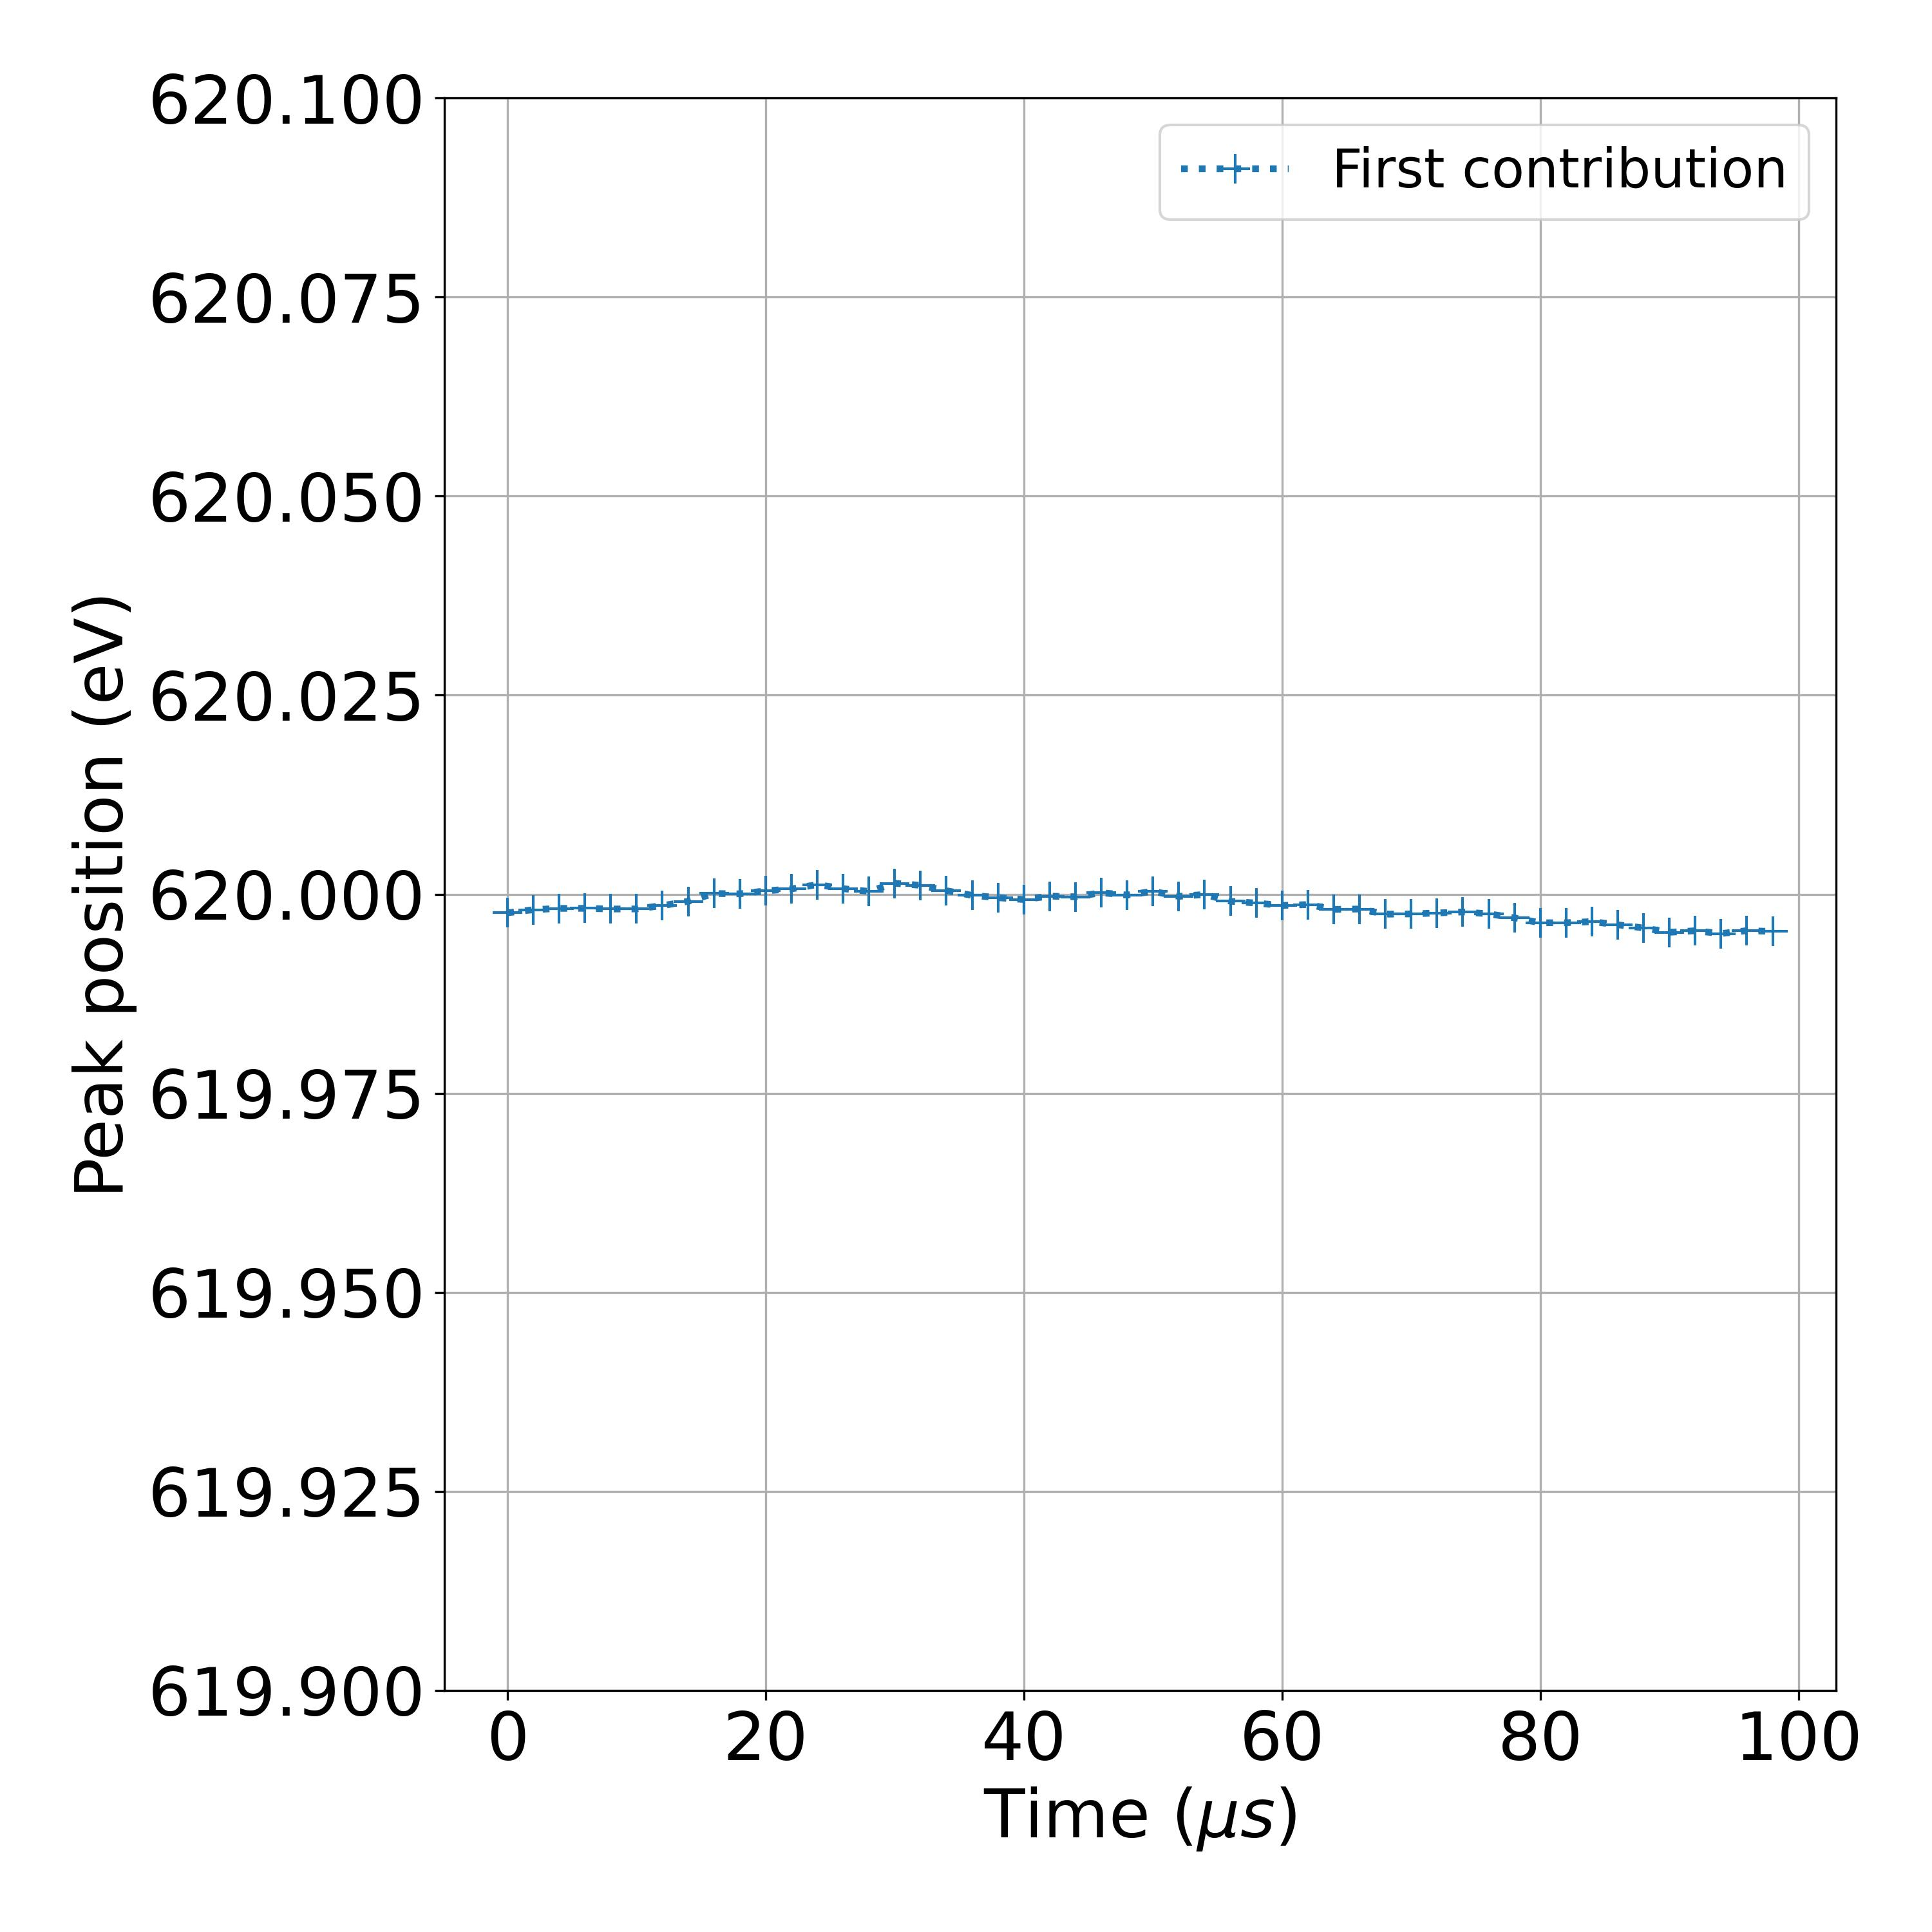
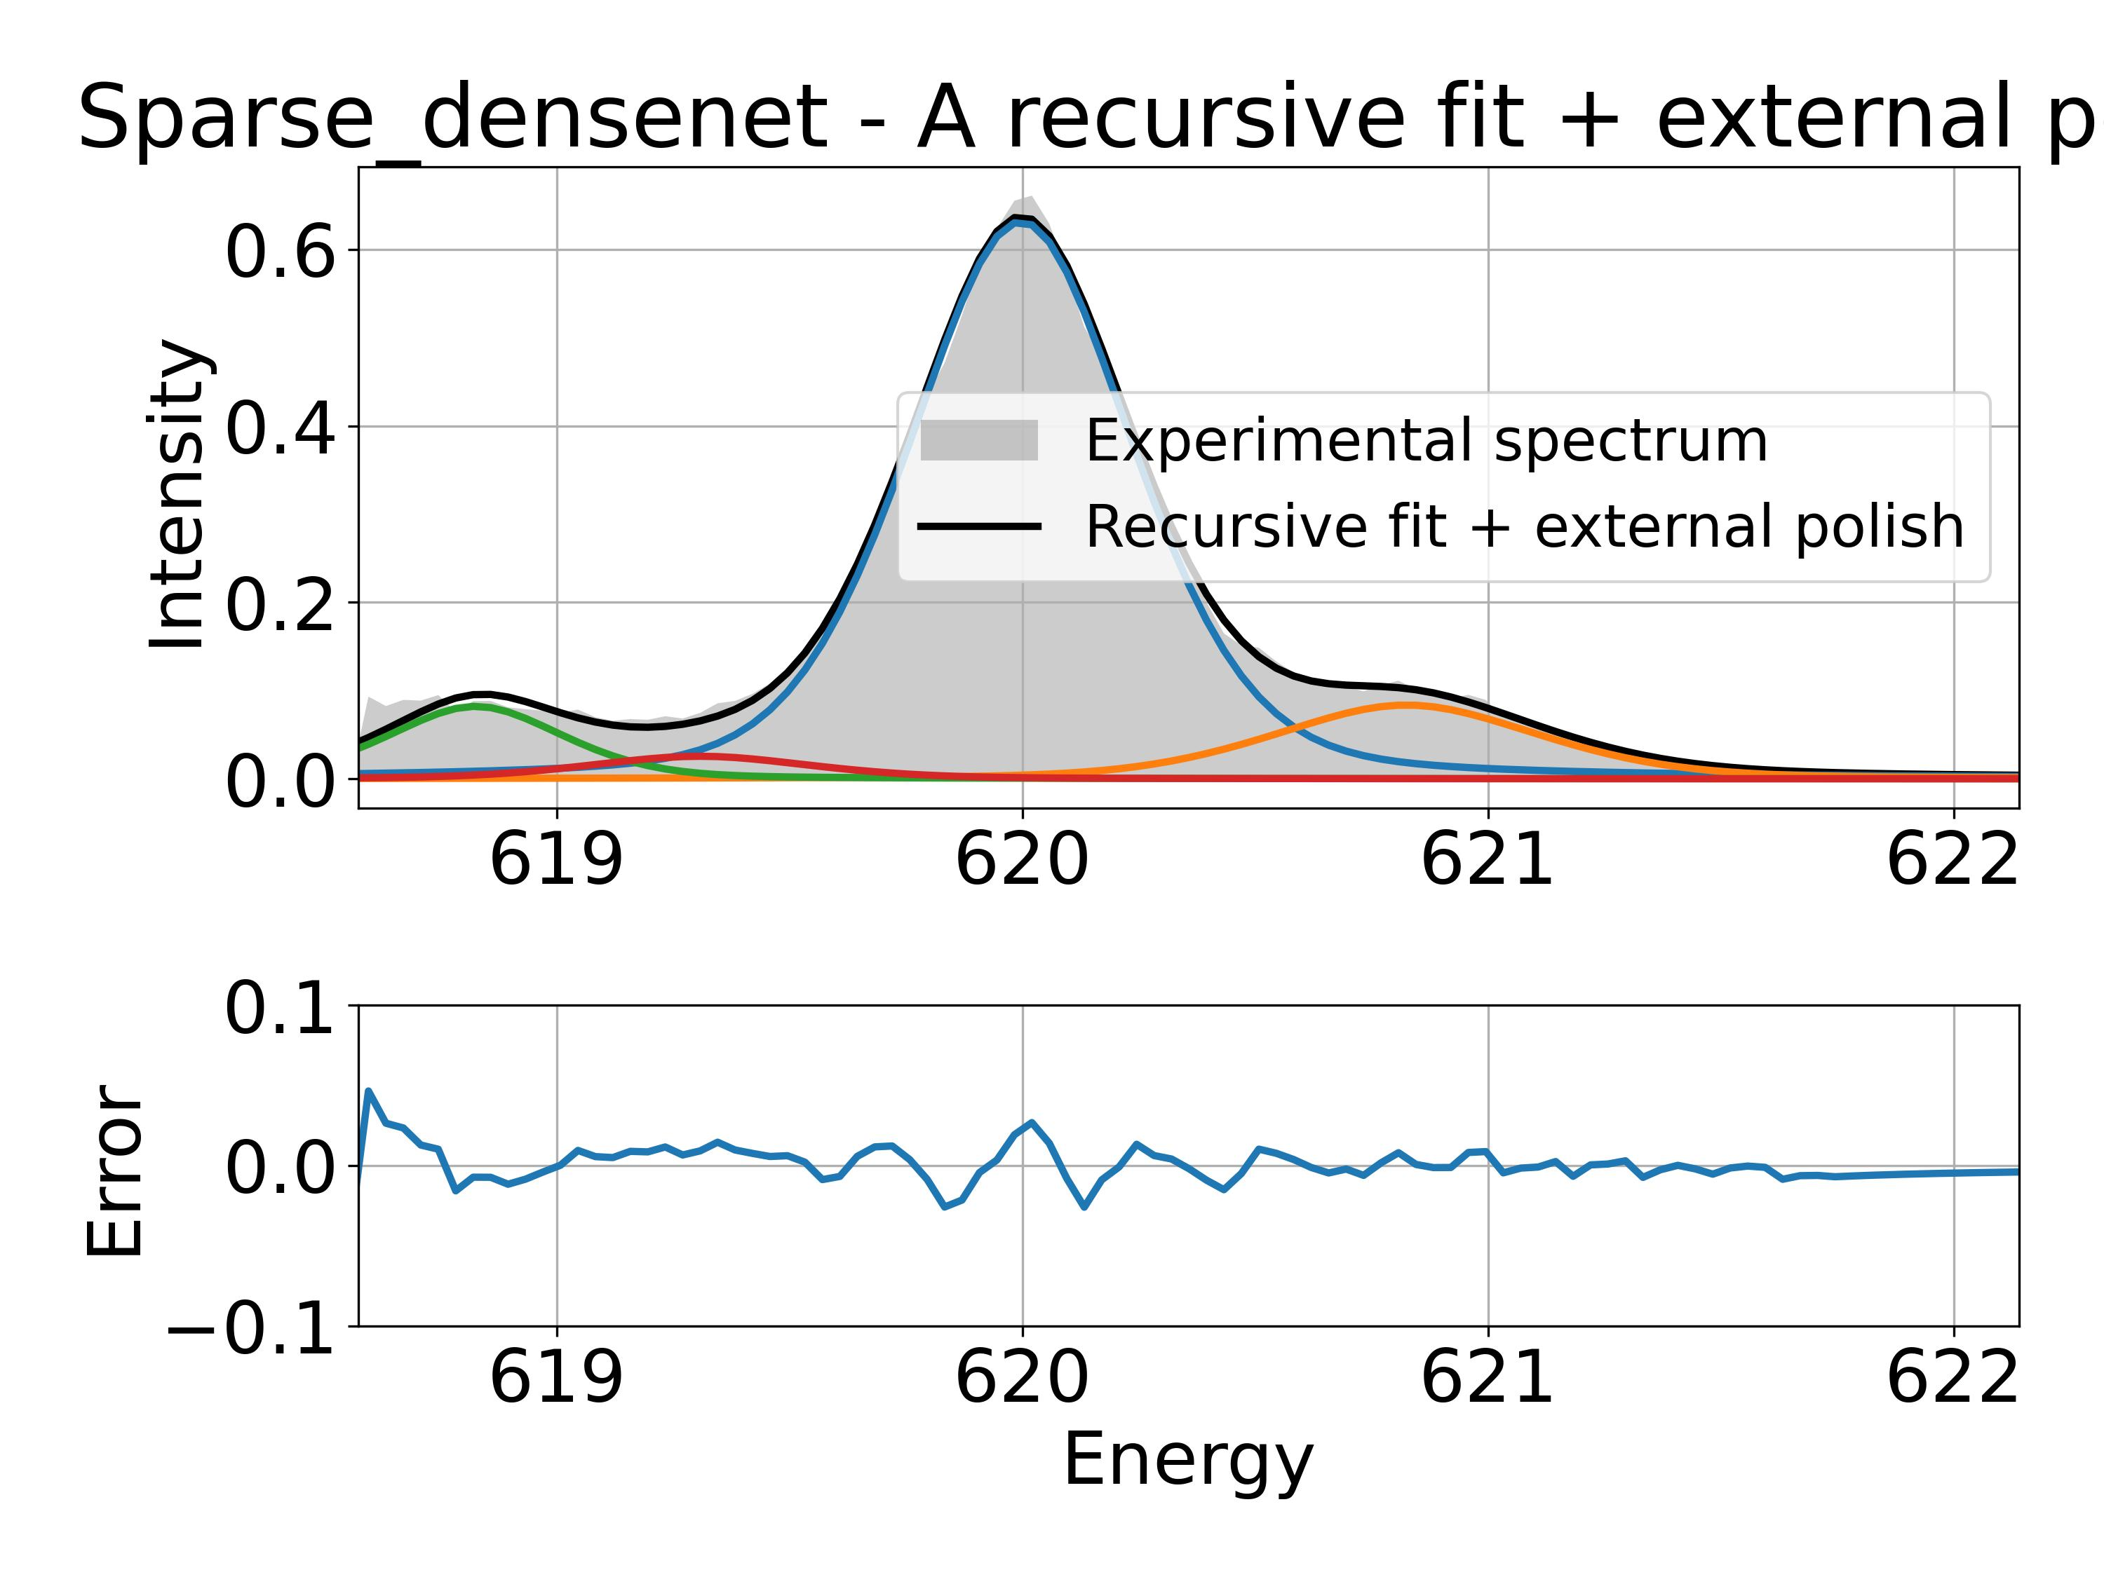
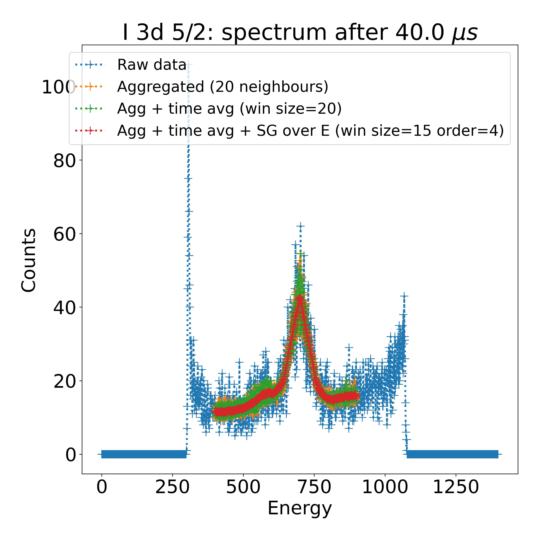
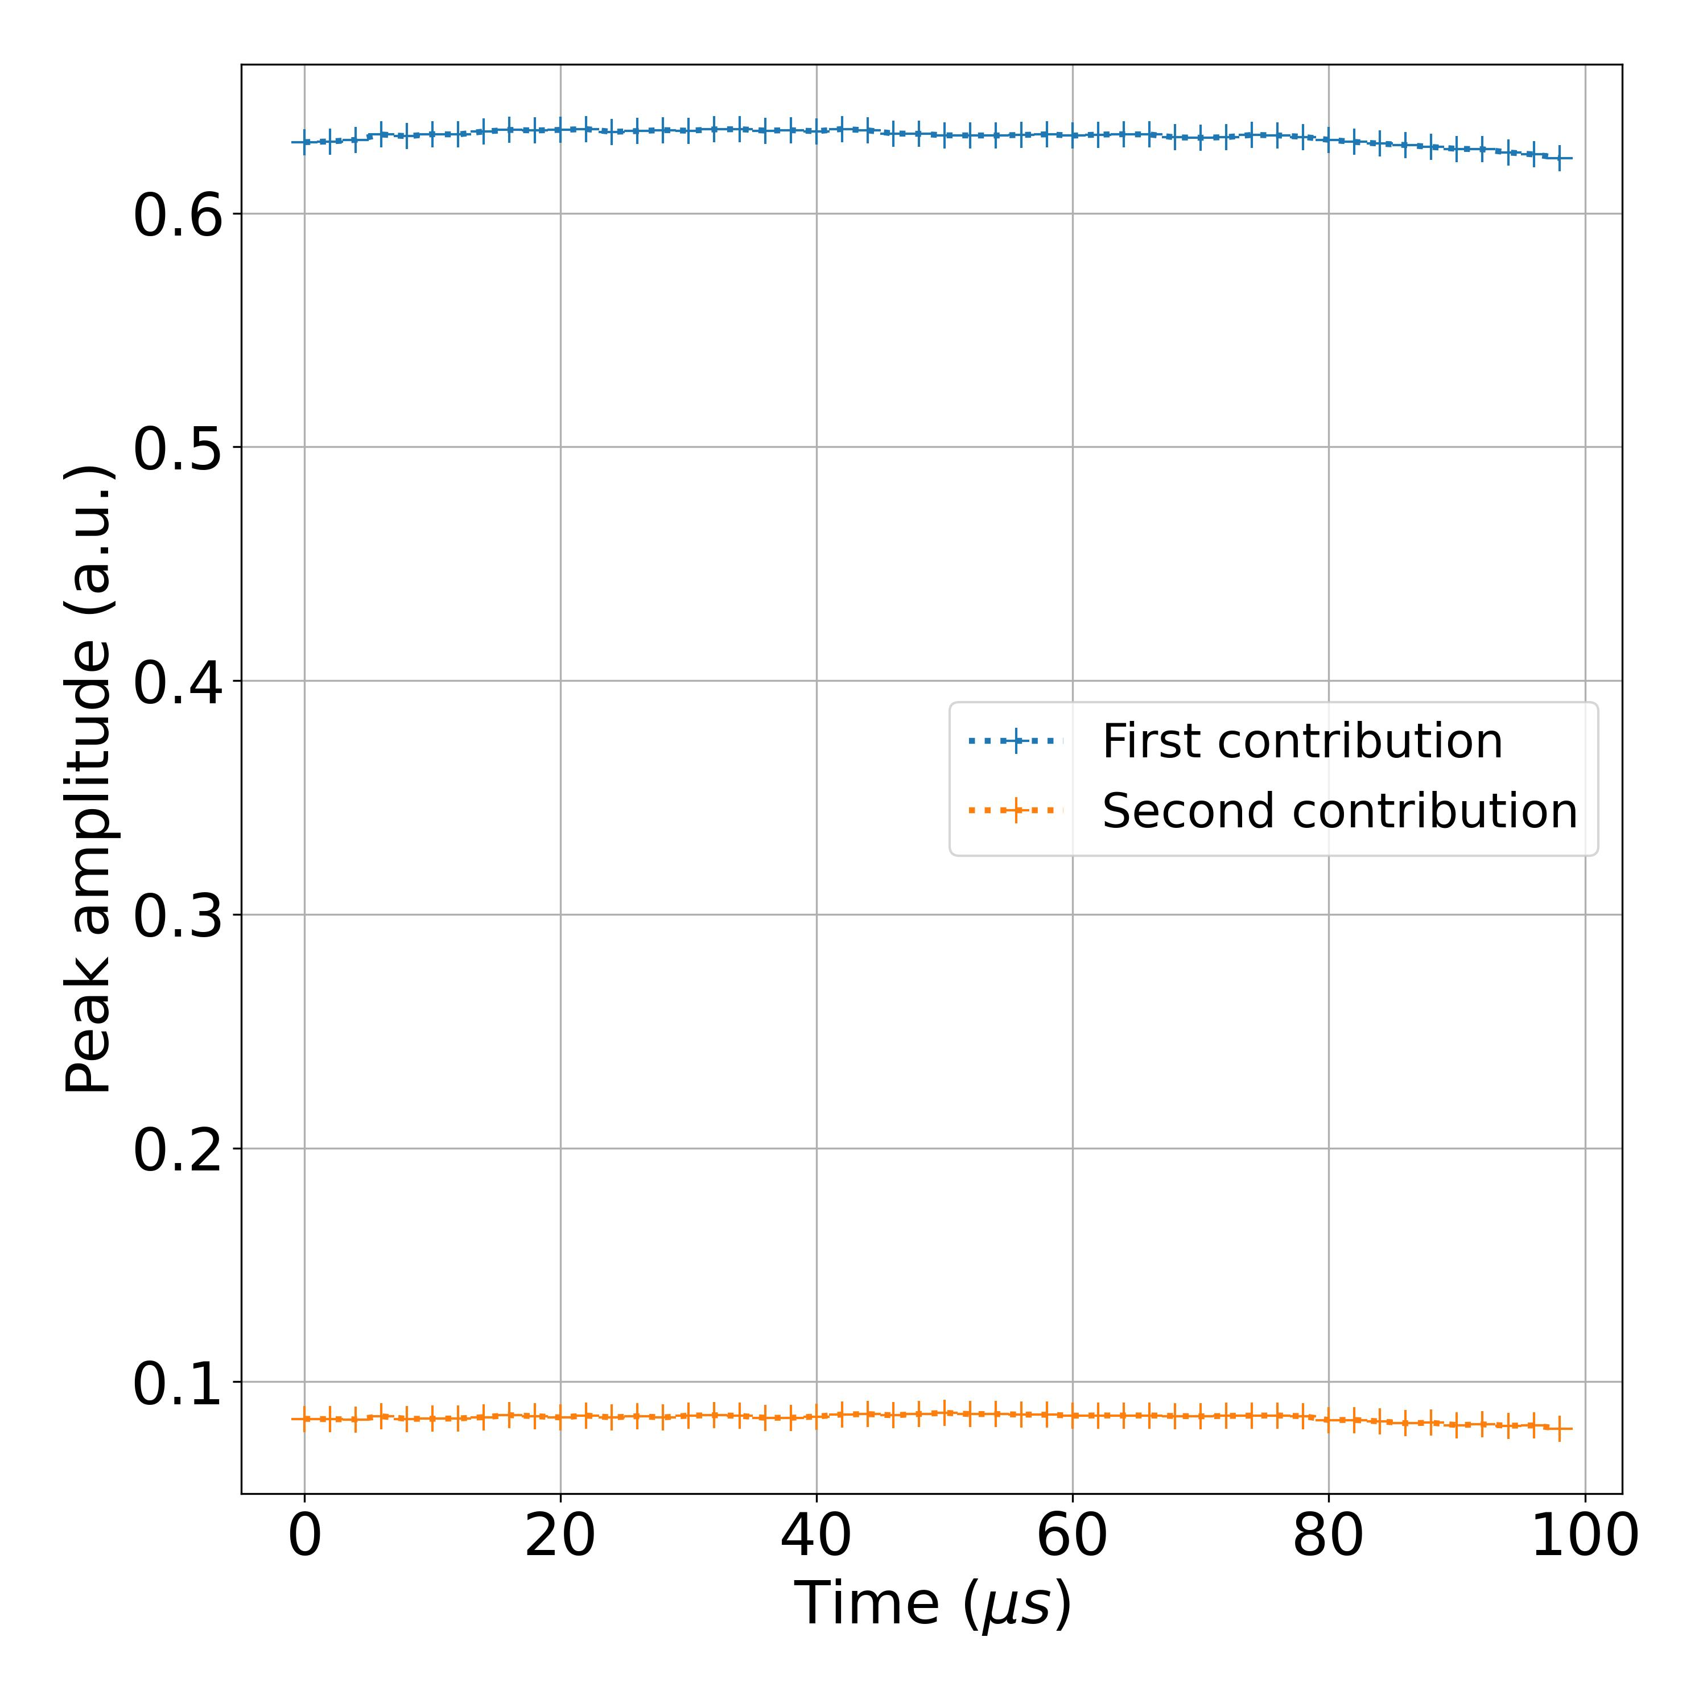
Results on experimental measurements
Measurement of I 3d
Evolution of two first peak contributions:
Total fit time (50 spectra): 4 min
3d 5/2
Laser off
Laser on
Filtering noisy experimental data
Need of better defined background ?

Slide 13
Conclusion
Training of convolutional neural network to find the major contribution
Application to experimental measurements
Analysis of time resolved XPS measurements
Recursive procedure to find all contributions
Tracking of contribution properties over time
Laser off
Laser on

